Slide 1
HOW MUCH DO UKRAINIANS KNOW ABOUT NATIVE AMERICANS?
Oksana Shostak
National Aviation University
March, 24, 2016
Applied_linguistics@ukr.net

Slide 2
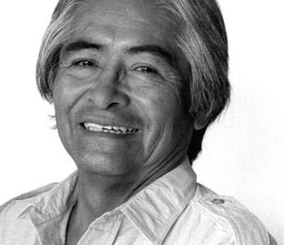
Simon Ortiz (Acoma Pueblo)
GREATEST BELIEVERS GREATEST DISBELIEVERS
To believe or not to believe,
this was the question.
And THE ANSWER.
Asked and answered and believed
by the greatest believers
and disbelievers the world
has ever known.
Where are the Indians?
Where are the real
Indians?
There are no Indians.
There are no real Indians.
There were never any Indians.
There were never any Indians.
There were never any real Indians.
You mean... you mean, there were never any Indians?
No real Indians?
None.
Never.

Slide 3
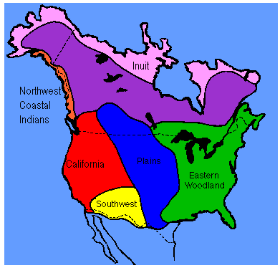
Native American Territories
In the United States, Native Americans are considered to be people whose pre-Columbian ancestors were indigenous to the lands within the nation's modern boundaries. These peoples were composed of numerous distinct tribes, bands, and ethnic groups, and many of these groups survive intact today as sovereign nations.

Slide 4
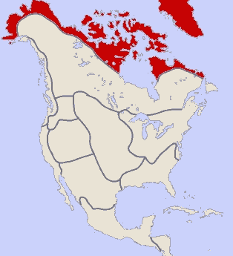
In the study of Native Americans, it is more evident to divide the Americas into geographic regions. There are 10 divisions (Culture Areas) for North America
The Arctic culture area is a cold, flat, treeless region (actually a frozen desert) near the Arctic Circle in present-day Alaska, Canada and Greenland, was home to the Inuit and the Aleut.

Slide 5
The Subarctic culture area, mostly composed of swampy, piney forests (taiga) and waterlogged tundra, stretched across much of inland Alaska and Canada.

Slide 6
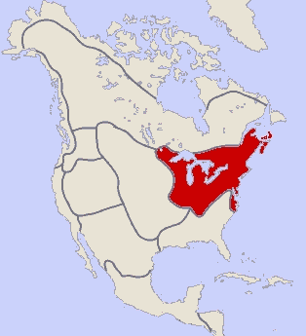
The Northeast culture area, one of the first to have sustained contact with Europeans, stretched from present-day Canada’s Atlantic coast to North Carolina and inland to the Mississippi River valley.

Slide 7
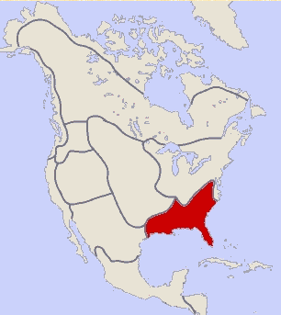
The Southeast culture area, north of the Gulf of Mexico and south of the Northeast, was a humid, fertile agricultural region.

Slide 8
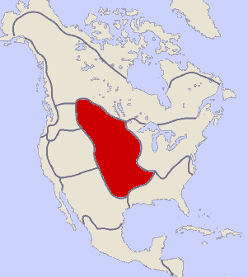
The Plains culture area comprises the vast prairie region between the Mississippi River and the Rocky Mountains, from present-day Canada to the Gulf of Mexico.

Slide 9
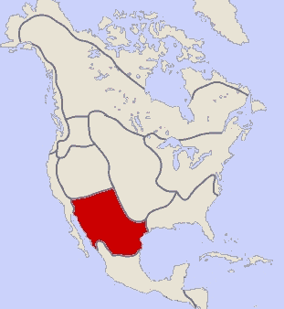
The peoples of the Southwest culture area, a huge desert region in present-day Arizona and New Mexico (along with parts of Colorado, Utah, Texas and Mexico) developed two distinct ways of life.

Slide 10
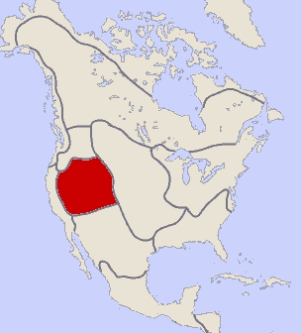
The Great Basin culture area, an expansive bowl formed by the Rocky Mountains to the east, the Sierra Nevadas to the west, the Columbia Plateau to the north, and the Colorado Plateau to the south, was a barren wasteland of deserts, salt flats and brackish lakes.

Slide 11
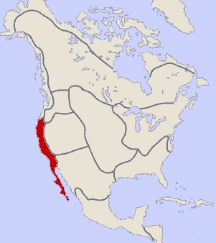
Before European contact, the temperate, hospitable California culture area had more people—an estimated 300,000 in the mid-16th century—than any other. It was also more diverse: Its estimated 100 different tribes and groups spoke more spoke more than 200 dialects.

Slide 12
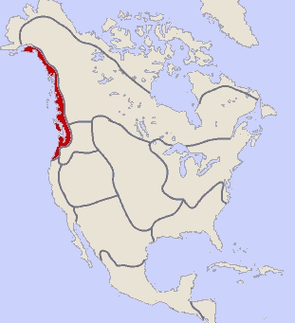
The Northwest Coast culture area, along the Pacific coast from British Columbia to the top of Northern California, has a mild climate and an abundance of natural resources.

Slide 13
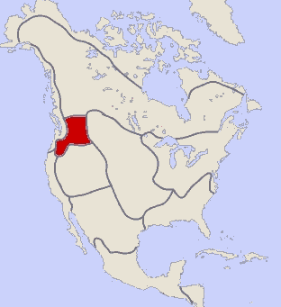
The Plateau culture area sat in the Columbia and Fraser river basins at the intersection of the Subarctic, the Plains, the Great Basin, the California and the Northwest Coast (present-day Idaho, Montana and eastern Oregon and Washington).

Slide 14
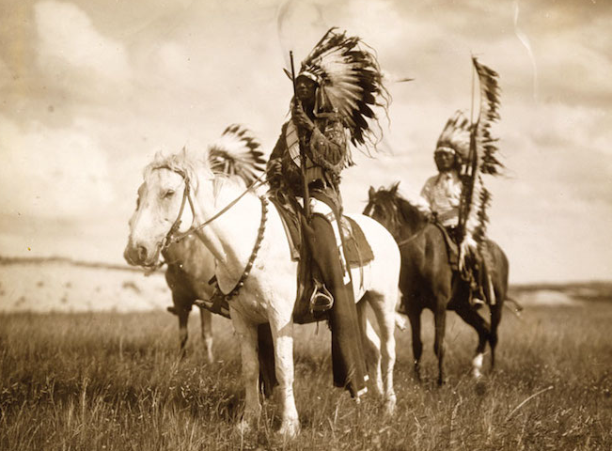
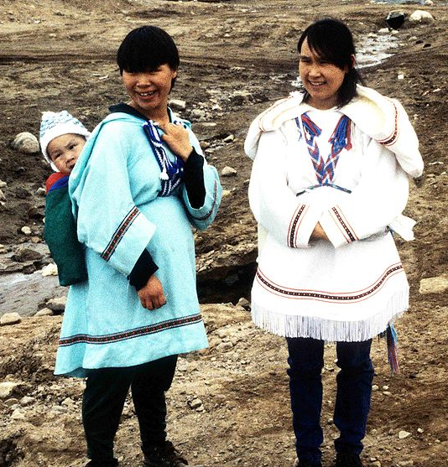
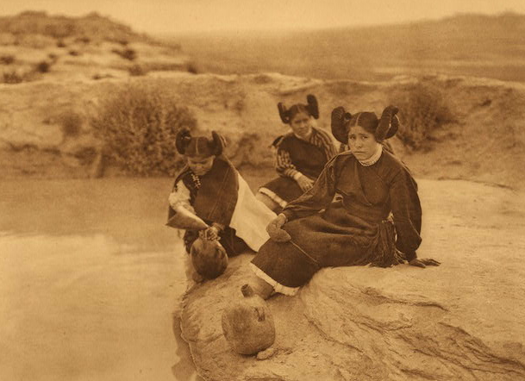
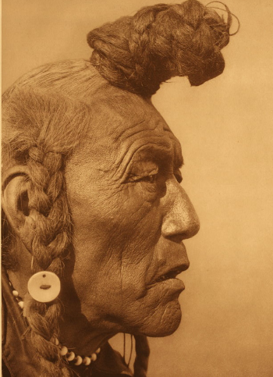
Appearance
Native Americans are the people living in North America. These people belong to different tribes and different ethnic groups. These are the original people of America and are separated to those people who at sometime, at some stage migrated to America. But it is also said that Native Americans were not “pure by family tree” because they belong to India and somehow are said as native Indians.

Slide 15
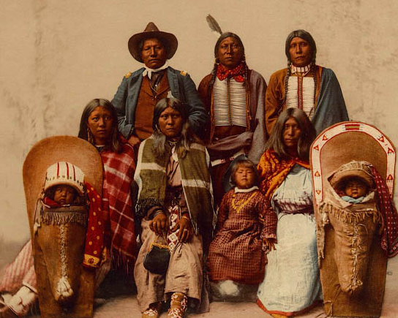
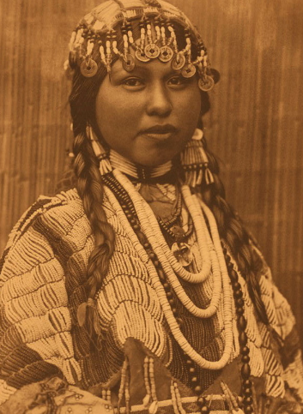
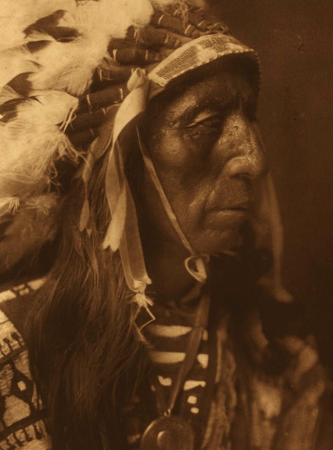
Nearly all Native Americans belong to one of five mitochondrial DNA haplogroups: A, B, C, D or X and all of these are widely distributed throughout America.
Ancient Native Americans had long hair and they were tough looking. They were hard working and that’s why they had tall and strong bodies. Their dresses were handmade and decorated with thread work and beads.

Slide 16
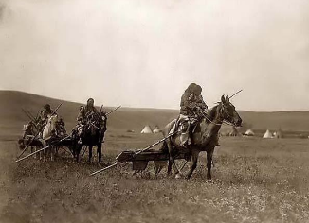
Native American Lifestyle
Native Americans were still nomadic when the first European settlers arrived in America - with each tribe split into smaller bands (of about 400). The bands moved 6-8 times a year, and camp could be broken (dismantled and packed up) in a few minutes. People put their belongings into buffalo-skin bags called parflèches, which were dragged on poles pulled by horses.

Slide 17
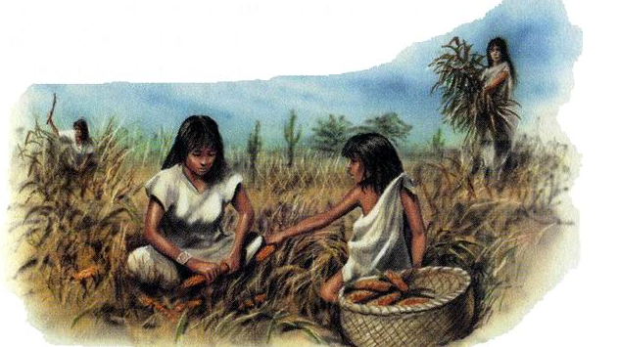
Native Americans were hunter-gatherers. They gathered maize, squash, beans and turnips (asking permission from the spirits of the land before pulling them up).

Slide 18
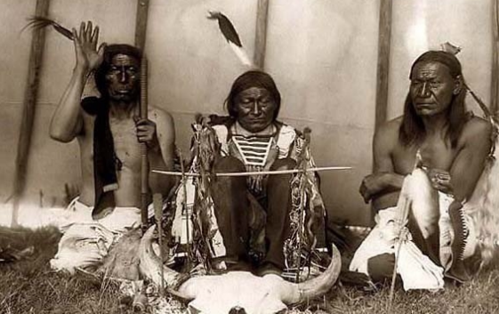
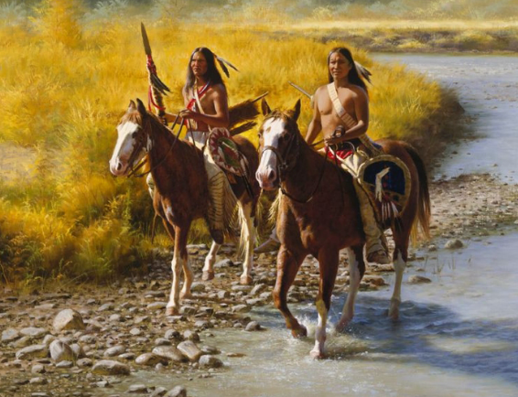
They also hunted deer, rabbits, ducks and turkeys, but the central event of their life was the buffalo hunt (on horseback).
Men and women had clearly defined roles. Men went off to the hunt and to war (on horseback).

Slide 19
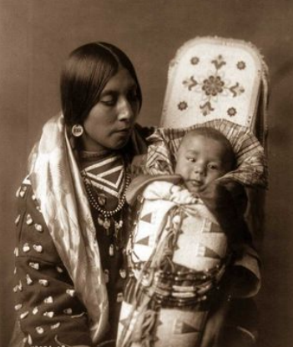
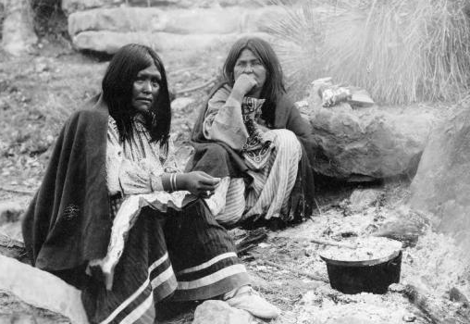
Women (and any males too timid to go through initiation) gathered food, stayed at home and looked after children. The women spent their leisure time decorating their clothes and tipis (tents) with beads and quills. The decorations often had a religious meaning.

Slide 20
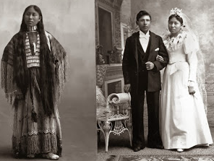
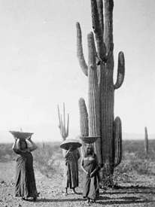
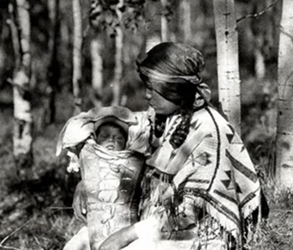
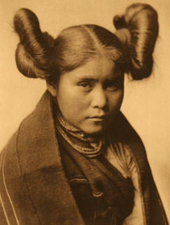
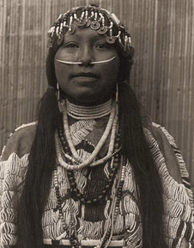
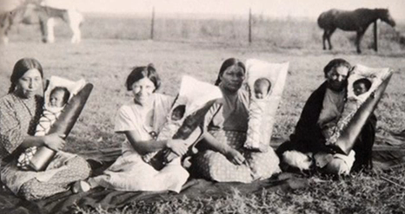
Women are accorded the highest respect and regard, for they are the portals through which a spirit comes to earth. Obviously, without this portal, it would not be possible for our spirits to come here for the growth and healing that we need. The man's role is therefore a supportive one, protecting the woman and family from harm, and providing those things that require strength.

Slide 21
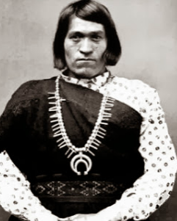
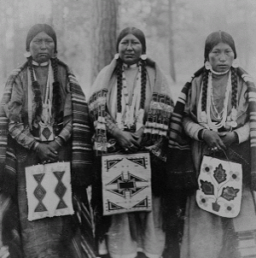
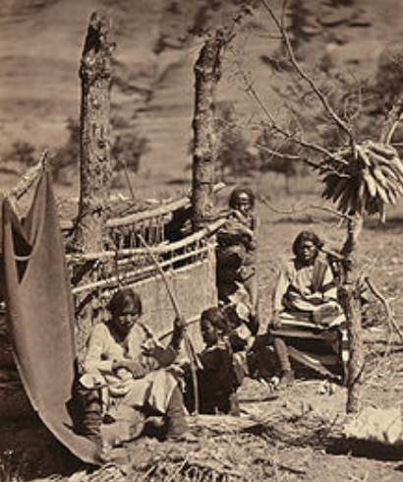
Native Americans had a matriarchal society. This means that the woman’s voice was heard very clearly when important decisions were being made. This, again, is attributable to their role as life-giver: when decisions that affect the future of the people are being made, the ones who gave birth to those people should have the controlling input to the decision. For example, if war was being considered, the woman’s point of view would not only take into account the reasons that war seemed to be required, it would also take into account the cost in human lives and suffering that would follow. For this reason, a woman's viewpoint provides a balance that a man is not equipped to provide. While the major leaders of the were males, they always listened carefully and respectfully to the voices of the female elders.

Slide 22
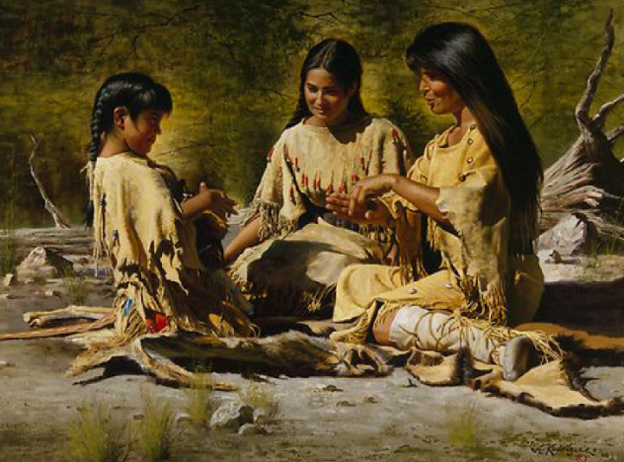
WOMEN AND CEREMONIES
A woman's roles and participation in ceremonies is governed in some ways by her unique gift. So long as a woman is capable of bringing life into the world, she also experiences her menses, or 'moon time.' During this time, her connection with the earth is extremely strong, as her body purifies itself and prepares itself to receive life. Energies are flowing through her into Mother Earth. This flow is so strong that she should never touch anyone’s sacred objects, because she would drain the energies from those objects and render them neutral, and therefore no longer sacred. In addition, she may even be capable of draining life energies from those around her, which is why women would go to a Moon Lodge that was separated from the regular living area. There she would be tended by female Elders, who are not affected by her purification.

Slide 23
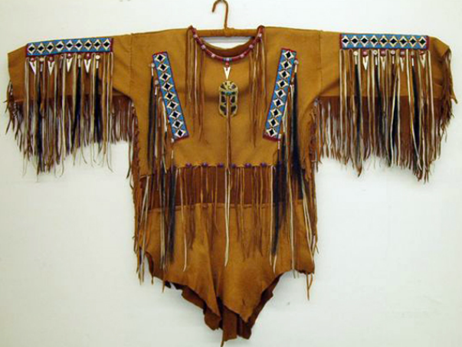
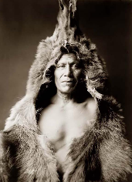
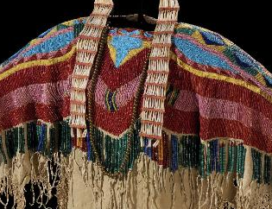
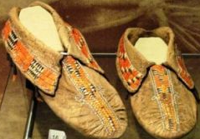
WHAT CLOTHING DID THEY WEAR?
Native American clothing is very close to an art form. The primary material used by Native Americans in their clothing was made from animal hides. The hides that were used were most commonly buffalo or deer. They were decorated with a variety of dyes made from different organic sources such as berries, roots, bark, grass and insects. Native American art is a window into their culture. All of the products that Native Americans used in their daily lives, helped develop their culture.

Slide 24
NATIVE AMERICAN HOUSING
There were many different types of American Indian houses in North America. Each tribe needed a kind of housing that would fit their lifestyle and their climate.
In and north of the United States there were some twenty well-defined types of native dwellings, varying from the mere brush shelter to the five-storied pueblo.
Some tribes were agricultural-- they lived in settled villages and farmed the land for corn and vegetables. They wanted houses that would last a long time. Other tribes were more nomadic, moving frequently from place to place as they hunted and gathered food and resources. They needed houses that were portable or easy to build.

Slide 25
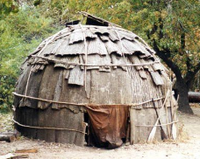
Wigwam Homes
are Native American houses used by Algonquian Indians in the woodland regions.
Wigwams are made of wooden frames which are covered with woven mats and sheets of birchbark.
Wigwams are good houses for people who stay in the same place for months at a time.

Slide 26
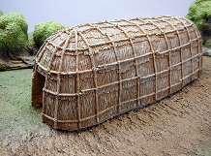
Longhouses
Longhouses are good homes for people who intend to stay in the same place for a long time. A longhouse is large and takes a lot of time to build and decorate.

Slide 27
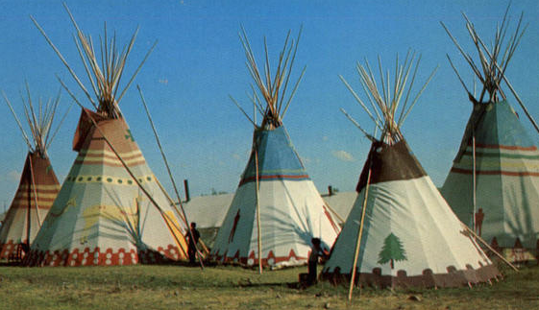
Tepees
are tent-like American Indian houses used by Plains tribes. A tepee is made of a cone-shaped wooden frame with a covering of buffalo hide.

Slide 28
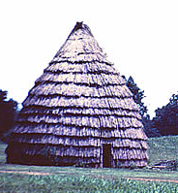
Grass Houses
Grass houses are American Indian homes used in the Southern Plains by tribes such as the Caddos. They resemble large wigwams but are made with different materials. Grass houses are made with a wooden frame bent into a beehive shape and thatched with long prairie grass.

Slide 29
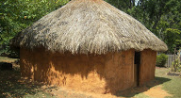
Wattle and Daub Houses
Wattle and daub houses (also known as asi, the Cherokee word for them) are Native American houses used by southeastern tribes. Wattle and daub houses are made by weaving rivercane, wood, and vines into a frame, then coating the frame with plaster. The roof was either thatched with grass or shingled with bark.

Slide 30
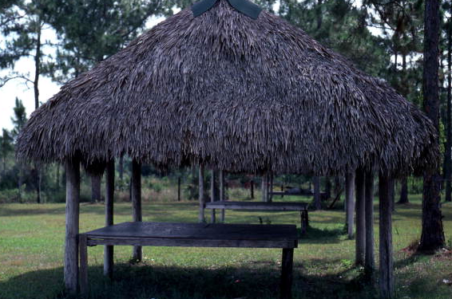
Chickees
Chickees (also known as chickee huts, stilt houses or platform dwellings) are Native American homes used primarily in Florida by tribes like the Seminole Indians. Chickee houses consisted of thick posts supporting a thatched roof and a flat wooden platform raised several feet off the ground. They did not have any walls.

Slide 31
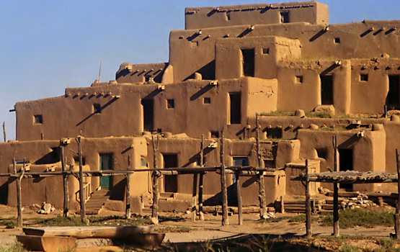
Adobe Houses
Adobe houses (also known as pueblos) are Native American house complexes used by the Pueblo Indians of the Southwest. Adobe pueblos are modular, multi-story houses made of adobe (clay and straw baked into hard bricks) or of large stones cemented together with adobe. Each adobe unit is home to one family, like a modern apartment. The whole structure, which can contain dozens of units, is often home to an entire extended clan.

Slide 32
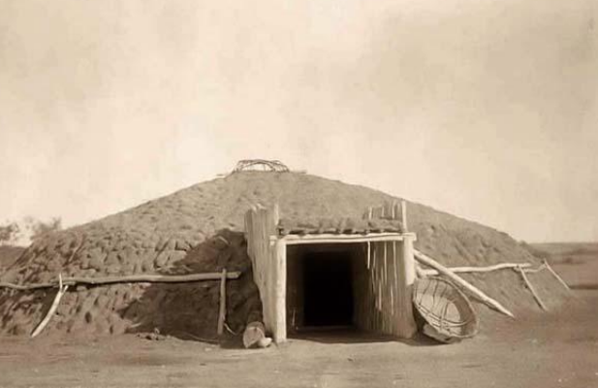
Earthen Houses
Earthen house is a general term referring to several types of Native American homes including Navajo hogans, Sioux earth lodges, subarctic sod houses, and Native American pit houses of the West Coast and Plateau. Earthen houses made by different tribes had different designs, but all were semi-subterranean dwellings -- basement-like living spaces dug from the earth, with a domed mound built over the top (usually a wooden frame covered with earth or reeds.)

Slide 33
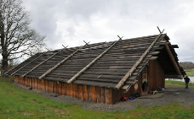
Plank Houses
Plankhouses are Native American homes used by tribes of the Northwest Coast (from northern California all the way up to Alaska.) Plank houses are made of long, flat planks of cedar wood lashed to a wooden frame. Native American plank houses look rather similar to old European houses, but the Indians didn't learn to build them from Europeans-- this style of house was used on the Northwest Coast long before Europeans arrived.

Slide 34
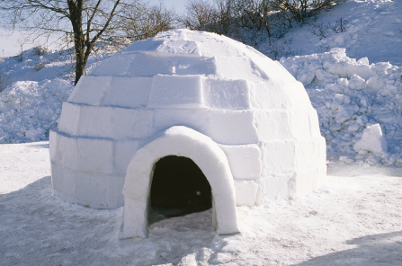
Igloos
Igloos (or Iglu) are snow houses used by the Inuit (Eskimos) of northern Canada. Not all Inuit people used igloos -- some built sod houses instead, using whale bones instead of wooden poles for a frame. Like a sod house, the igloo is dome-shaped and slightly excavated, but it is built from the snow, with large blocks of ice set in a spiral pattern and packed with snow to form the dome.

Slide 35
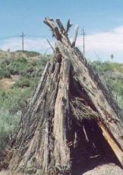
Brush Shelters
Brush shelters (including wickiups, lean-tos, gowa, etc.) are temporary Native American dwellings used by many tribes. Brush shelters are typically very small, like a camping tent. People cannot usually stand up straight inside brush lodges -- they are only used for sleeping in. A brush shelter is made of a simple wooden frame covered with brush (branches, leaves, and grass.) The frame can be cone-shaped, with one side left open as a door, or tent-shaped, with both ends left open.

Slide 36
Simon Ortiz (Acoma Pueblo)
"Indians" who are our people
(The People, Human Beings, Hanoh, etc.)
knew themselves as people. Different from each other. Speaking
different and distinct and separate languages. They heard each others'
languages. Their people had different names. They wore different
clothes. They ate different foods. They danced different dances. They
celebrated their differences. Yes, they were different but they were all
the same:
The People, Human Beings, You, Me.

Slide 37
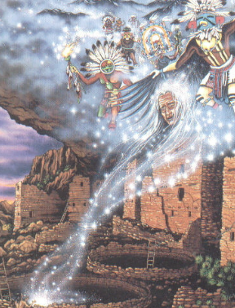
THE PERSONAL LEVEL OF SPIRITUALITY
Native Americans have a number of spiritual attributes, such as the spirit name and spirit guide, that are part of their being whether they are aware of them or not. Learning of these things allows to properly acknowledge their roles in their lives, and helps to use the attributes to find and stay on the paths, there are a number of different ways to determine their attributes, including asking a knowledgeable spiritual leader for a Naming Ceremony. However, with prayer and with careful attention to signs, they are often able to determine these for themselves, if they can listen patiently with their hearts for the answers.

Slide 38

SPIRIT NAMES
According to the teachings, they have a spirit name from the moment their spirit first comes into existence, and the name follows them from life to life, and back into the spirit world afterwards. For this reason, they are not “given” a spirit name by someone; they can only be reminded of the name they already carry. It is possible, however, that a person's spirit name will be added to, depending on the roles and experiences that are given to that person. If you ask for your name, be prepared to accept it as it is given to you, even if it is not something you may have hoped for remember, this name has been yours for much longer than you might think, and its importance reflects into many levels of existence. There is generally a connection between the spirit name and the Spirit Guide, but it may not be obvious.

Slide 39

DIRECTION
Each Native American has one (or occasionally more) of the four directions that is important for them, because it allows them to make best connection with spiritual energies and knowledge. If they address their prayers to this direction, or face this way when they sleep or meditate, they are at the most receptive for spiritual guidance. They may be able to determine their own direction simply by closing eyes and facing each of the cardinal points of the compass, and waiting for a slight surge of energy or a feeling of connection. However, because the sensation can be subtle, it is important to do this without preconceptions or a desired direction, so that the head does not deceive the heart.

Slide 40

THE COMMITMENTS
In every Naming Ceremony they have performed or attended, the participants have been asked to agree to several commitments. Generally, each has been required to abstain from recreational drugs, and to limit or abstain from alcohol consumption. Each was also required to promise to do everything within their power to guide people away from having abortions. The strictness of these commitments may vary from person to person, and a given individual may have additional commitments to make as well. In each case, the nature of the commitments was uniquely suited to each individual.

Slide 41

PERSONAL SACRED ITEMS
Examples include things like eagle feathers or whistles, buffalo teeth, bear claws, and so forth. However, other items may also come your way, such as items you are given as part of a ceremony, or even things that you find that have some undefined but undeniable connection with the spirit. These things become part of the collection of personal sacred items, and should be treated with utmost respect. They are generally kept in a medicine bundle, and should be wrapped in red cloth for protection. They should be brought out periodically to refresh the connection with them and to remind of how they came to them.

Slide 42

THE SACRED PIPE
A long time ago, during a time of famine, a woman appeared, wearing white buffalo skin, and carrying a sacred pipe. She explained that the wooden stem was for the trees, and everything growing on earth, the red bowl symbolized the flesh and blood of all people, and the smoke was the breath of their prayers going to the Creator. The woman showed the people the pipe ceremony, where offerings were made to the four directions, while drums were played, and sacred songs were sung. The people learned of the connection between the sky and the earth and the unity of all life. They learned that offering thanks to the Creator with the pipe would yield many blessings here on earth. Before leaving, the woman said that she would return when the time was ripe. Then she turned into a buffalo, changing colors several times. Finally, she changed into a white buffalo calf, and disappeared into the distance. The people followed her teachings and were hungry no more.

Slide 43


SMUDGING CEREMONY
This ceremony will acknowledge the seven sacred directions. The first four directions are the four main directions of the compass: East, South, West and North. When a Native American prays to the four directions, it is a prayer to the spirits of the world, to life and the Great Spirit that encompasses the four directions and everything that is.

Slide 44

The Medicine Wheel
The Medicine Wheel is a symbol that incorporates the four directions. Its spokes point east, south, west, and north. The four quarters are colored white, yellow, red and black, representing the races of man, the seasons, and the stages of life from childhood to old age. The circle is the earth, the moon and the planets. It is the circle of life and all creation. The circle is traveled clockwise, following the motion of the sun in the sky. In addition, Native Americans will honour three more directions: the sky, the Creator, and the Earth.

Slide 45


Population
At the time of European arrival in America, the number of Native Americans was about 1.2 billion.
Today there are about 2 million Native Americans in US and about 1 million in Canada.

Slide 46


Famous Native American Tribes
Cherokee, Navajo, Choctaw, Sioux, Apache, Iroquois and Latin American Indian were the famous and most powerful tribes of America. They all ruled for more than 200 years on America. Among them Cheorkee had highest number of people that was about 729,533 people.

Slide 47
Modern Native American Life
Native American life is different today than it was centuries ago, but there is still a great degree of pride and independence in Native American life. Pride in one’s tribe, care of the land and respect for nature characterize native American life, and many Native Americans share these principles today.
Many Native Americans today live on reservations, but in generations past, they spanned the continent and their lifestyles and traditions varied from tribe to tribe as they do today. Some Native Americans survived by hunting and gathering and lived in tents, while others lived in complex longhouses and had a very organized and complex political system.
Native American life also included a unique view of spirituality and health. The American Indians knew what we are discovering today, the mind and the spirit play a critical role in physical illness and healing. Native American life also was characterized by love of nature, and today’s concern about conservation and environmentalism are inspired by views which were and still are the hallmarks of Native American life.

Slide 48


Do Native Americans still live in houses like these today?
Most Native Americans do not live in old-fashioned Indian houses.
The only Native American housing style on this page that is still in regular use as a home is Indian adobe houses. Some Pueblo families are still living in the same adobe house complexes their ancestors used to live in. There are also a few elders on the Navajo reservation who still prefer to live in hogans. But otherwise, traditional Native American houses like these are usually only built for ritual or ceremonial purposes, such as a sweat lodge or tribal meeting hall. Most American Indians today live in modern houses and apartments, just like North Americans from other ethnic groups.

Slide 49

Nowadays Famous Native Americans
Demi Moore
is an American actress, filmmaker, former songwriter, and model.

Slide 50

Navarre Scott Momaday
(born February 27, 1934) — known as N. Scott Momaday — is a Native American author of Kiowa descent. His work House Made of Dawn was awarded the Pulitzer Prize for Fiction in 1969. Momaday received the National Medal of Arts in 2007 for his work that celebrated and preserved Native American oral and art tradition. He holds 20 honorary degrees from colleges and universities, and is a fellow of the American Academy of Arts and Sciences

Slide 51

Louise Erdrich
(born Karen Louise Erdrich, June 7, 1954) is an Ojibwe writer of novels, poetry, and children's books featuring Native American characters and settings. She is an enrolled member of the Turtle Mountain Band of Chippewa Indians, a band of the Anishinaabe (also known as Ojibwe and Chippewa)

Slide 52

Sherman Joseph Alexie, Jr.
(born October 7, 1966) is an American poet, writer, and filmmaker. Much of his writing draws on his experiences as a Native American with ancestry of several tribes, growing up on the Spokane Indian Reservation. He lives in Seattle, Washington.

Slide 53

Rose Marie "Tantoo" Cardinal
CM (born July 20, 1950) is a Canadian film and television actress.

Slide 54

John Bennett Herrington
(born September 14, 1958 in Chickasaw Nation) is a retired United States Naval Aviator and former NASA astronaut. In 2002, Herrington became the first enrolled member of a Native American tribe to fly in space. (William R. Pogue was of Choctaw ancestry and was a crewman aboard Skylab 4 in 1973–1974, but he was not an enrolled member of the Choctaw.)

Slide 55

Gary Paul Davis
(born March 1, 1969), better known by his stage name Litefoot, is a Native American rapper, actor, and the founder of the Red Vinyl record label. He also portrayed Little Bear in the movie The Indian in the Cupboard, and Nightwolf in Mortal Kombat Annihilation.

